Slide 1


HEP NTUA Weekly Report 10/11/2021
George Bakas

Slide 2
Summary
ttX analysis:
Combination of all years in Fiducial level
Unfolding
Show systematic variations after unfolding for Parton and Particle levels
Unfold using the bulk sum of response matrices from all years
Combination of each variation in fiducial
Unfolding for each combined variation → combination of acceptance/efficiency and responses
ttX round table presentation on 27th of October
We have been writing the AN
Systematic Variations
Theory variations
Efficiency & acceptance comparison
Kolmogorov testing Response matrices
Z’ analysis
Writing documentation for PhD thesis

Slide 3
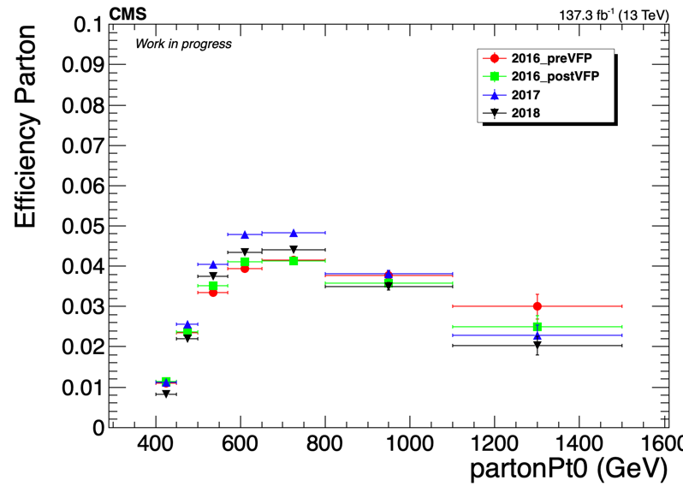
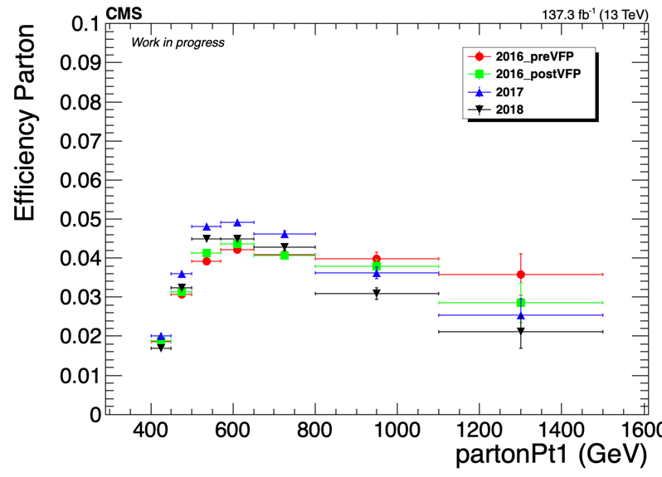
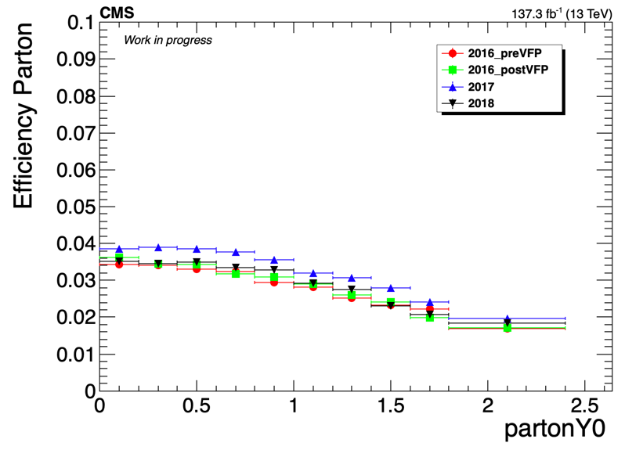
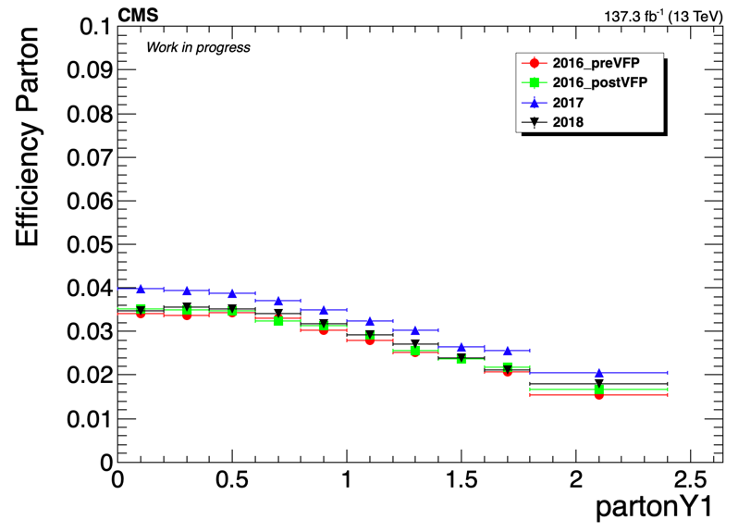
Efficiency Comparison

Slide 4
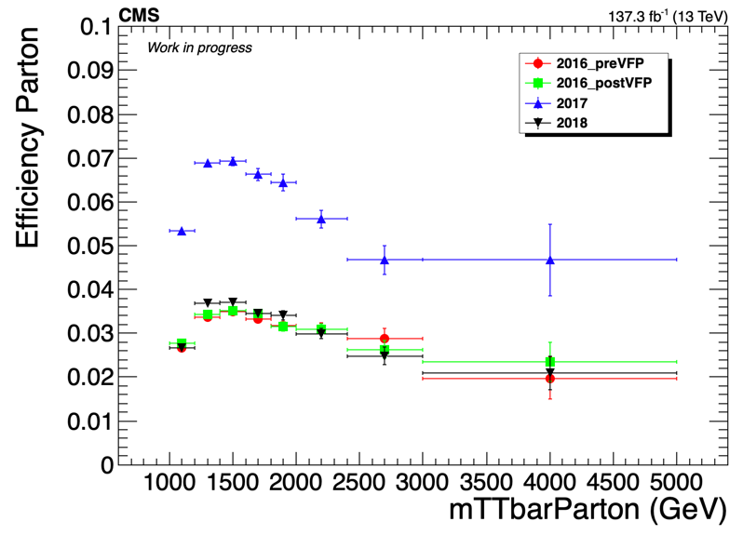
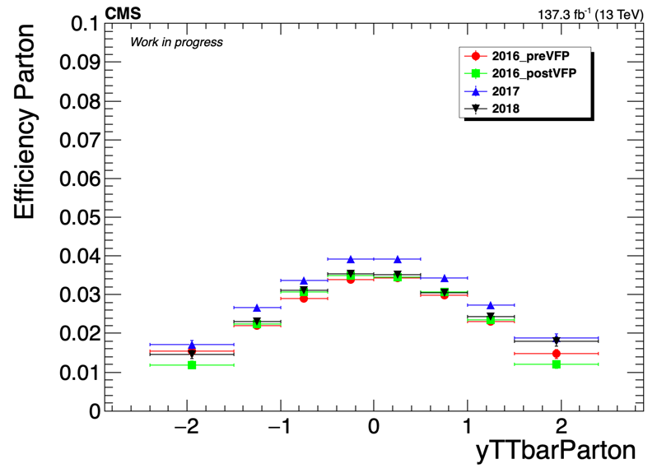
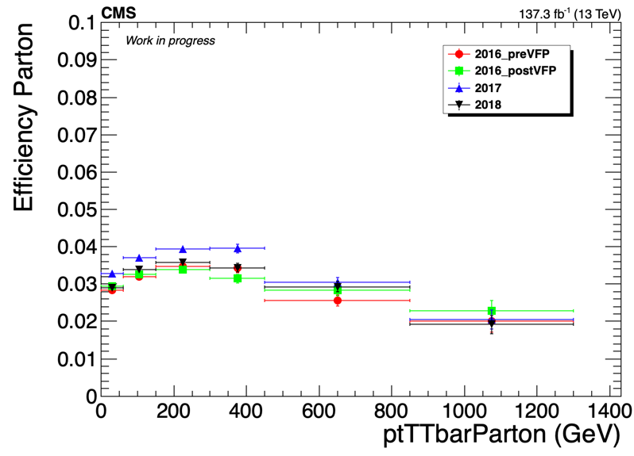
Efficiency Comparison

Slide 5
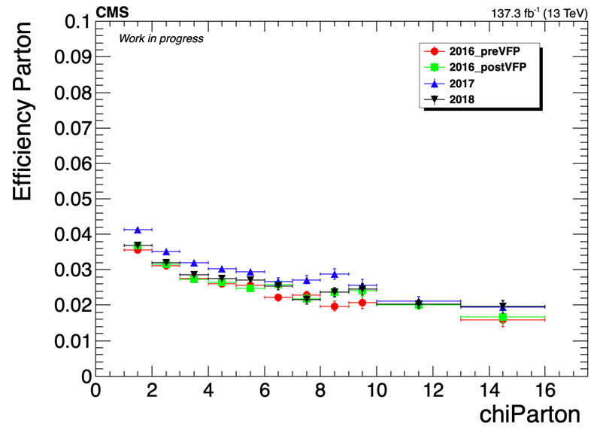
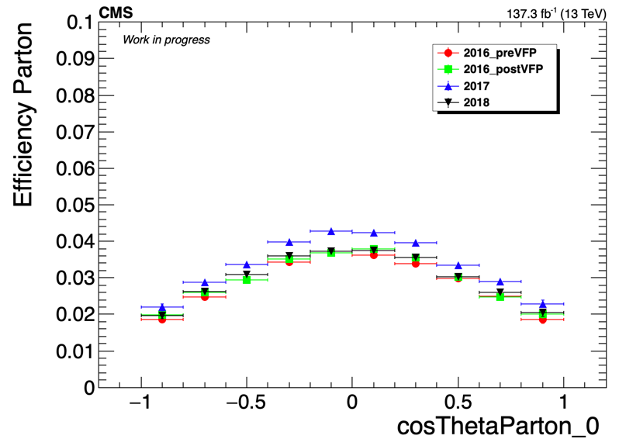
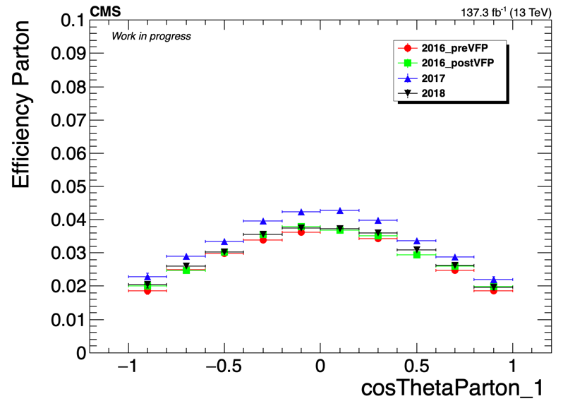
Efficiency Comparison

Slide 6
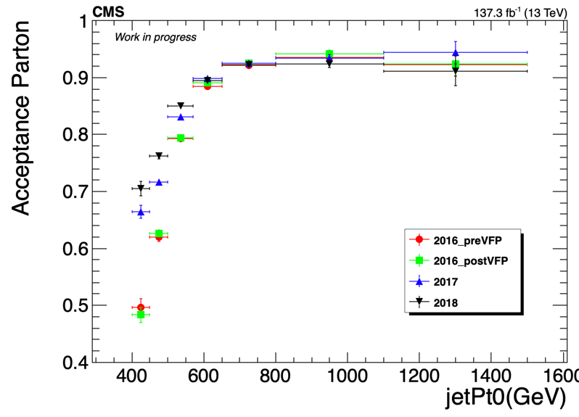
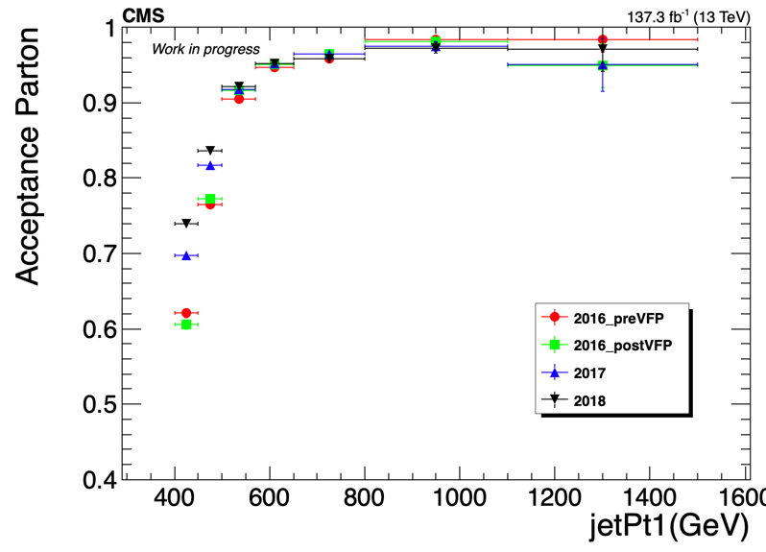
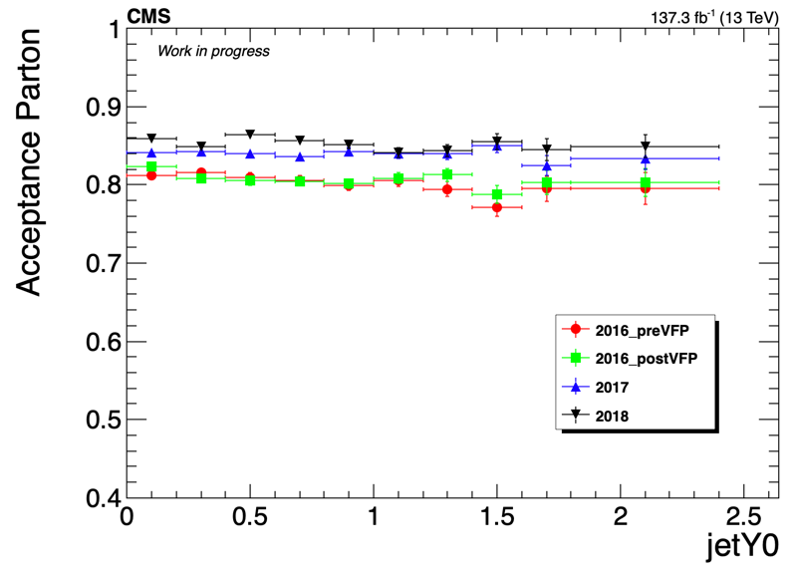
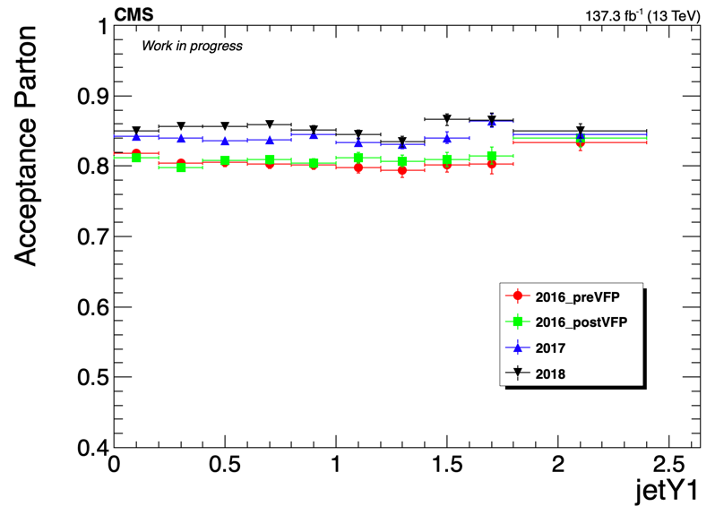
Acceptance Comparison

Slide 7
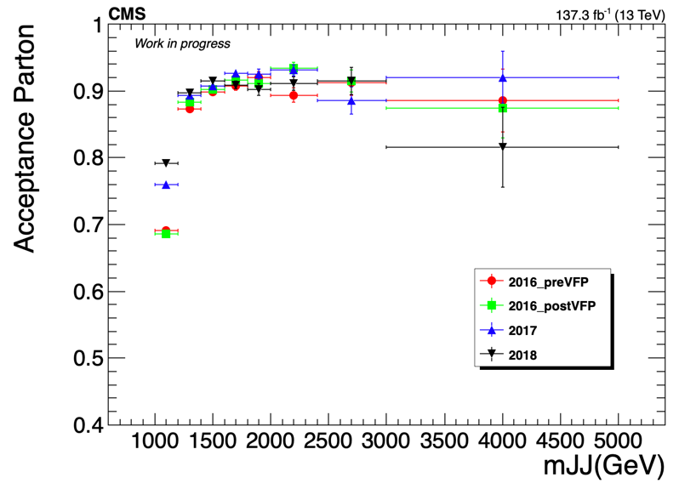
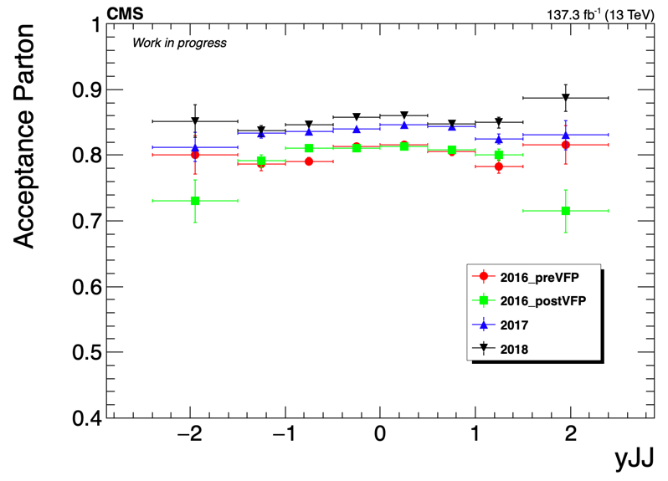
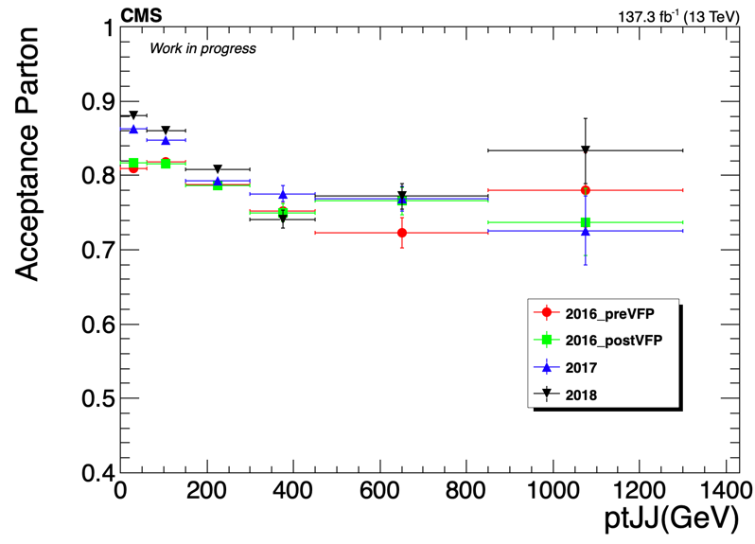
Acceptance Comparison

Slide 8
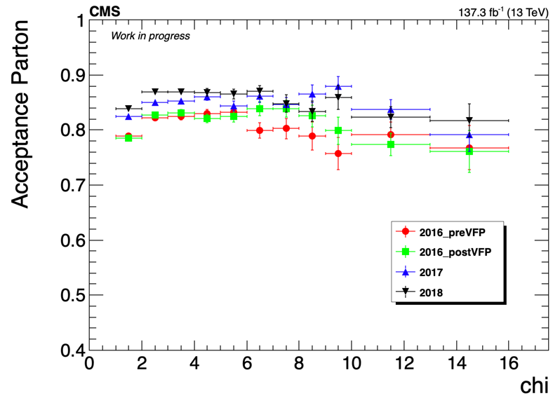
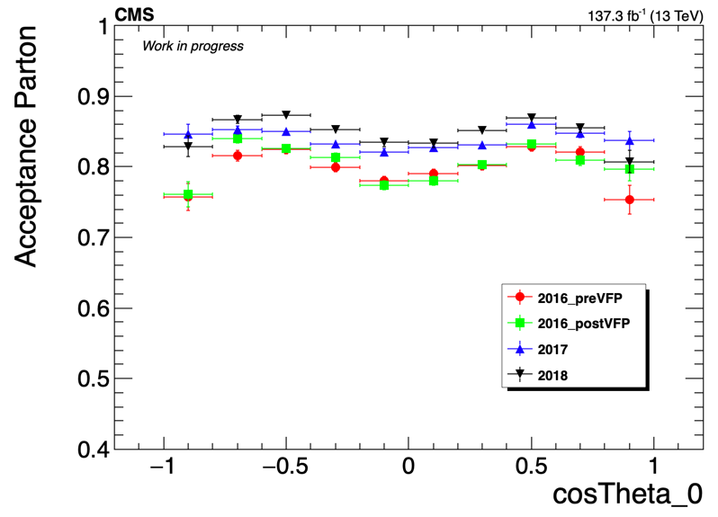
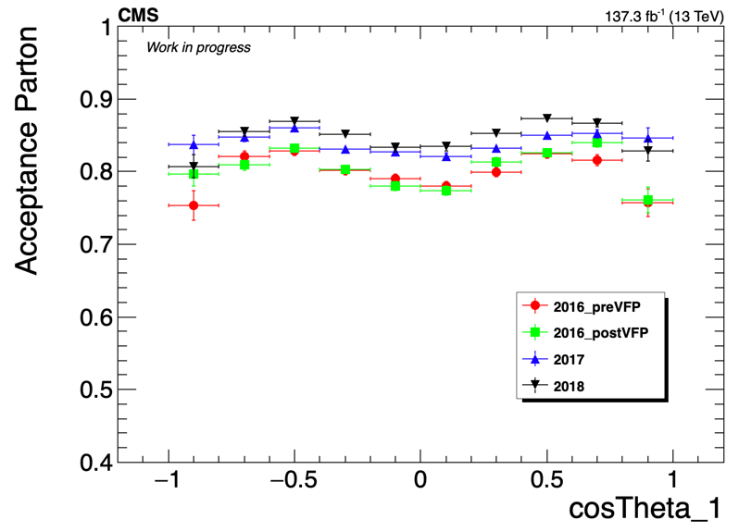
Acceptance Comparison

Slide 9
Kolmogorov Response matrices Tests mJJ
Statistical test of compatibility in shape between two histograms, using Kolmogorov test. much less than one means NOT compatible
 | 2016preVFP | 2016postVFP | 2017 | 2018
2016preVFP | 1 | 1 | 0.0369 | 6.83e-05
2016postVFP | 1 | 1 | 0.017 | 1.96e-05
2017 | 0.167 | 0.221 | 1 | 0.355
2018 | 0.029 | 0.058 | 0.619 | 1
reference

Slide 10
Kolmogorov Response matrices Tests ptJJ
much less than one means NOT compatible
 | 2016preVFP | 2016postVFP | 2017 | 2018
2016preVFP | 1 | 1 | 0.258 | 0.538
2016postVFP | 0.993 | 1 | 0.927 | 0.82
2017 | 0.547 | 1 | 1 | 0.963
2018 | 0.953 | 1 | 0.996 | 1
reference

Slide 11
Kolmogorov Response matrices Tests yJJ
much less than one means NOT compatible
 | 2016preVFP | 2016postVFP | 2017 | 2018
2016preVFP | 1 | 1 | 1 | 1
2016postVFP | 1 | 1 | 1 | 1
2017 | 1 | 1 | 1 | 1
2018 | 1 | 1 | 1 | 1
reference

Slide 12
Kolmogorov Response matrices Tests jetPt0
much less than one means NOT compatible
 | 2016preVFP | 2016postVFP | 2017 | 2018
2016preVFP | 1 | 1 | 0.009 | 7.52e-07
2016postVFP | 1 | 1 | 0.023 | 2.049e-06
2017 | 0.07 | 0.25 | 1 | 0.216
2018 | 0.005 | 0.029 | 0.454 | 1
reference

Slide 13
Kolmogorov Response matrices Tests chi
much less than one means NOT compatible
 | 2016preVFP | 2016postVFP | 2017 | 2018
2016preVFP | 1 | 1 | 1 | 1
2016postVFP | 1 | 1 | 1 | 0.985
2017 | 1 | 1 | 1 | 1
2018 | 1 | 1 | 1 | 1
reference

Slide 14
BACKUP

Slide 15
Summary
ttX analysis Pipeline Creation
We want to be able to handle all Nominal files and their variations in an automated way
This requires deciding consistent naming conventions and a efficient planning
Handling of:
Nominal
Parton Shower Weights
PDF Variations
JES
Scale Variations
bTagVariations
Top quark mass variations
Per year For all these we need to
Create template files that have 2btag and 0btag in Extended and Reduced jetMassSoftDrop phase space
9 variables (mJJ, pTJJ, yJJ, jetPt[0,1], jetY[0,1], chi, |cosTheta*|[0,1]
Template fit files (bkg qcd, bkg subdominant) and signal templates for all variations
Fit on extended signal region for all variations
Response matrices, Acceptance, Efficiency
Signal Extraction
Combine all Fiducial Level results (4 years) into 1 Extracted Signal for all variations
Unfold the combined result into Parton & Particle levels
Show systematic variations compared to the Nominal file
The same procedure must be done using different nominal files
Fill in 2btag histograms in our signal region in the parton
For each variation and each year
Combine all years together
Calculate systematics for samples other than the nominal

Slide 16
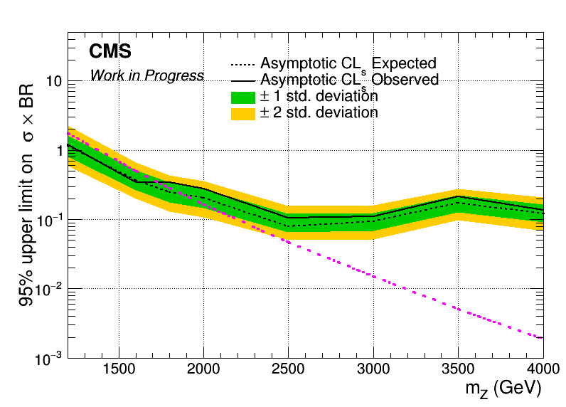
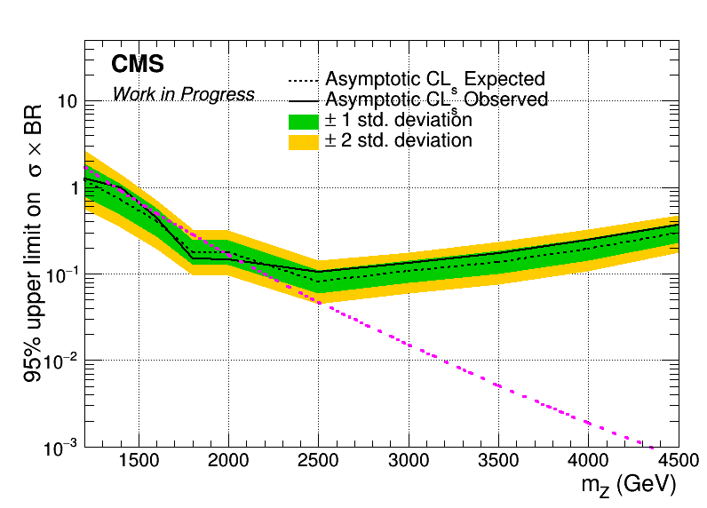
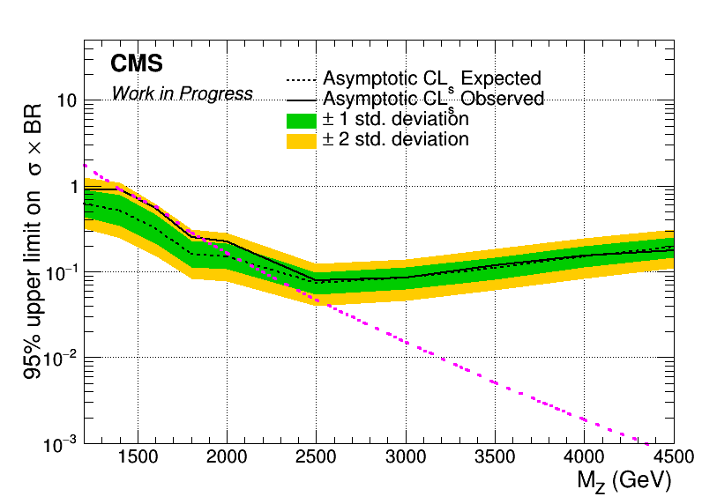
Brazilian Plots (2016_preVFP, 2017 and 2018) with sliding mJJ Cut
2016_preVFP
2017
2018

Slide 17
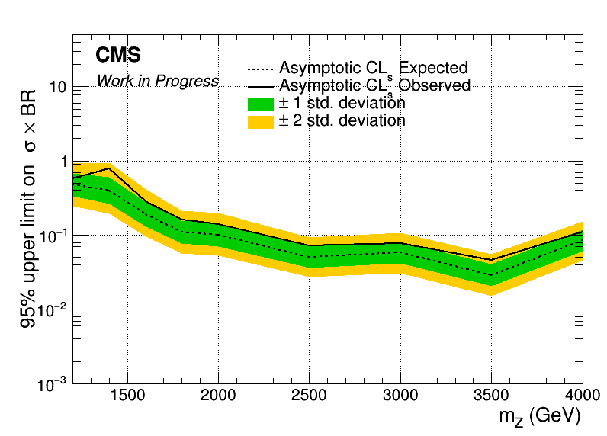
Combined Datacard for 2016_preVFP, 2017 and 2018
Mass Cut Mapping
{"mZ_1200_12":1000, "mZ_1400_14":1200, "mZ_1600_16":1400, "mZ_1800_18":1600, "mZ_2000_20":1600,
"mZ_2500_25":2000, "mZ_3000_30":2000, "mZ_3500_35":2000, "mZ_4000_40":2000, "mZ_4500_45":2000}

Slide 18
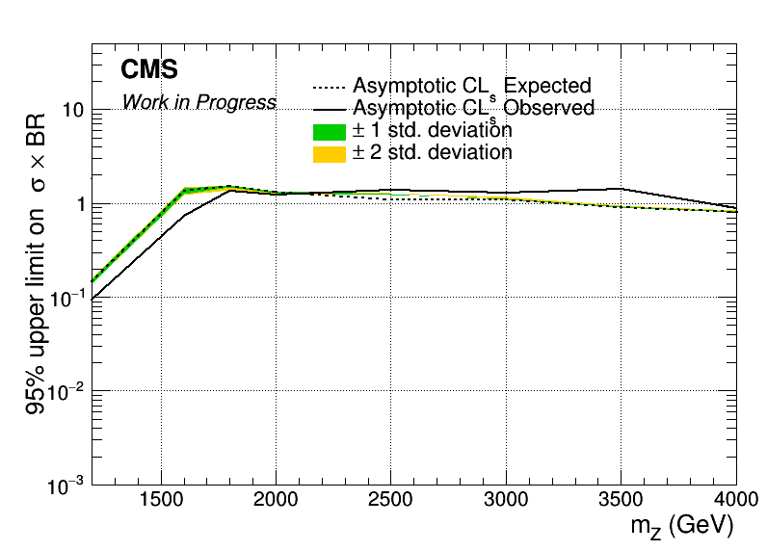
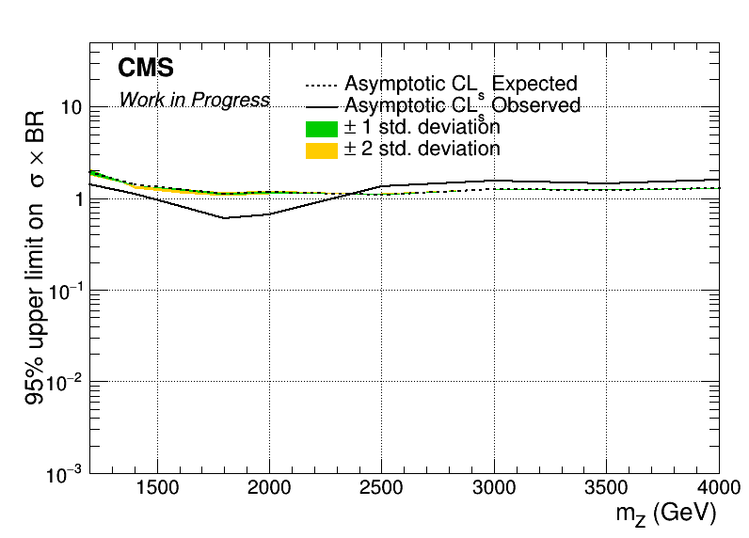

Brazilian Plots (2016_preVFP, 2017 and 2018) with sliding mJJ Cut wrt 2018
2016_preVFP
2017
2018

Slide 19
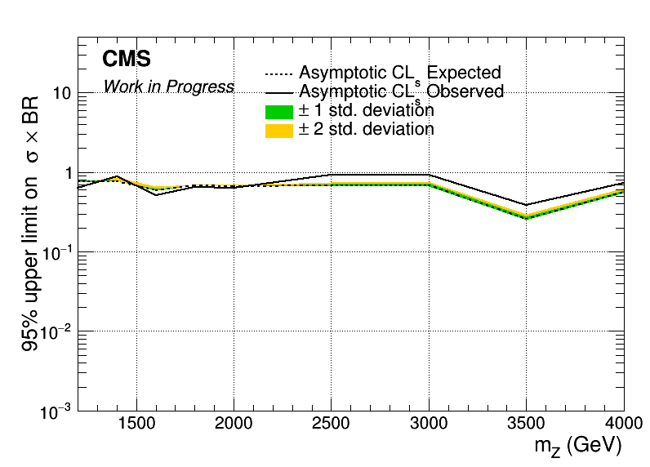
Combined Datacard for 2016_preVFP, 2017 and 2018 wrt 2018
Mass Cut Mapping
{"mZ_1200_12":1000, "mZ_1400_14":1200, "mZ_1600_16":1400, "mZ_1800_18":1600, "mZ_2000_20":1600,
"mZ_2500_25":2000, "mZ_3000_30":2000, "mZ_3500_35":2000, "mZ_4000_40":2000, "mZ_4500_45":2000}

